Slide 1
Board friendly financial presentations
Florida Conference of SDA
Business Managers
Efrain Murillo-Under treasurer,
Texas Conference of sda

Slide 2
Remember
Most board members ARE NOT accountants
Make your presentations as simple as possible
A graph is worth a thousand words (statements)
Use terminology that is understood by the non-accountant
Consolidate your Financial Statements for Board Presentations
Present differences between Actual and Budget in Graphs
Present financial changes thru various periods/comparisons
Present Income and Expense distributions in graphs with percentages
Give the Board the complete set of Financial Statements even if they don’t understand them (for your protection)

Slide 3
Remember
Prepare your self to answer most questions by studying your financial statements
Send your Financial Statement to board members ahead of meeting
Smart Budgeting means budget Lower on Income Higher on Expenses
Present the total budget on ONE graph

Slide 4
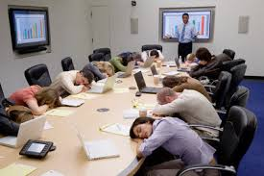
AVOID

Slide 5
Your Goal
Engaged Board
Involved
Understanding
Interested
Engaged Board
Definition:
Board members are understanding, interested and involved in your presentation.

Slide 6
If your Board is
Engaged by
UNDERTANDING,
INTERESTED
and
INVOLVED
Board will be Equipped to
make Better Financial Decisions
OUTCOME

Slide 7
Use terminology that is understood by the non-accountant
Statement of Changes in Net Assets
Income Statement/
Profit & Loss

Slide 8
Use terminology that is understood by the non-accountant
Statement of Financial Position
Balance Sheet
Keep the official tittle but explain with better know terminology

Slide 9
Consolidate your Financial Statements for Board Presentations
Combined Statement of Financial Position
Balance Sheet
 | June 2018 | June 2017 | Variance
Total Assets | 4,054,022.14 | 2,771,279.00 | 1,282,743.14
Total Liabilities | 2,305,683.39 | 2,259,770.77 | (45,912.62)
Total Net Assets | 1,748,338.75 | 511,508.23 | 1,236,830.52
Total Liabilities & Net Assets | 4,054,022.14 | 2,771,279.00 | 1,282,743.14

Slide 10
Explain
 | June 2018 | June 2017 | Variance
Total Assets | 4,054,022.14 | 2,771,279.00 | 1,282,743.14
Total Liabilities | 2,305,683.39 | 2,259,770.77 | (45,912.62)
Total Net Assets | 1,748,338.75 | 511,508.23 | 1,236,830.52
Total Liabilities & Net Assets | 4,054,022.14 | 2,771,279.00 | 1,282,743.14
This is what you own
This is what you owe
This is what you are worth

Slide 11
Present differences between Actual and Budget in Graphs
Budgeted Income Vs Actual

Slide 12
Present differences between Actual and Budget in Graphs
Budgeted Expenses Vs Actual

Slide 13
Present financial changes thru various periods/comparisons
Cash Comparison
Cash
Is
King

Slide 14
Net Assets comparison

Slide 15
Income distribution and %

Slide 16
Expense Distribution and %

Slide 17
Yearly budget
Make sure you send complete budget to all board members before the meeting.
Encourage questions prior to the meeting by email, phone or in person
The more questions you can answer prior to the meeting the better your presentation will go
Spent ENOUGH time preparing your budget. This is one of the most important financial tools of the institution
As much as possible, budget low on income and higher on expenses
Try to budget no more than 95% of the previous year’s enrollment
Make you budget presentation understandable for the Non-Accountant

Slide 18
Yearly Budget
Use Graphs to explain your budget
Use 1 graph to summarize the complete budget
Study and present carefully every budget assumption
Use columns for at least:
Last Year Actuals, Last Year Budget, Revised/Proposed Budget, Variance

Slide 19
Budget Assumptions Example
230 Students (Actual right now is 243)
0% Increase in Payroll
0% Increase in tuition
Increases in Student Employment Expenses
Reduction in the Security Department to only Part Time Employees
Payroll
School Counselor-Full Time
Director of Admissions from Hourly to Salary
Assistant Chaplain/International Students coordinator
Part Time Cafeteria Assistant
Part Time ESL Teacher
Basic Christianity teacher increase to 3 classes
Camp Ramah income of $136,000.00
Contract Maintenance 2 FTs to Begging Addressing Our decaying Campus $67,500.00
Increases in Utilities Expenses
Additional funding to repair Campus Housing $25,000.00
$126,000.00 To Address Bells, Chairs, 1st Stage of

Slide 20
One Graph to summarize complete budget

Slide 21
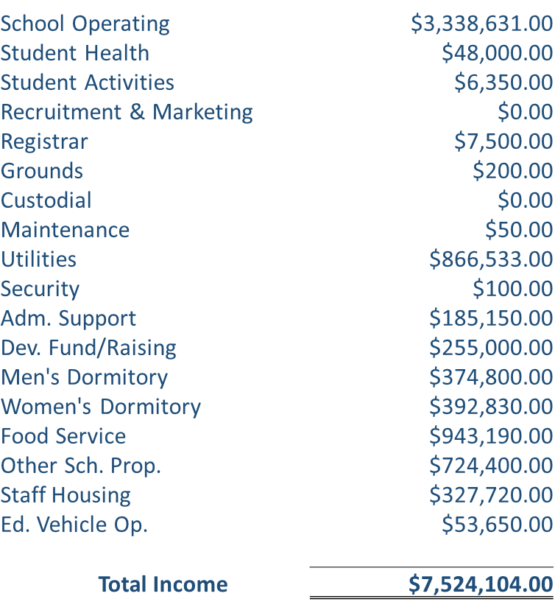
Income Summary

Slide 22
Income Distribution

Slide 23
Student Generated Income

Slide 24
Non-Student Generated Income
CCC Subsidy | $ 493,051.00
Industry Rental Income | $ 724,400.00
Housing Rental Income | $ 327,720.00
 | $ 1,545,171.00

Slide 25
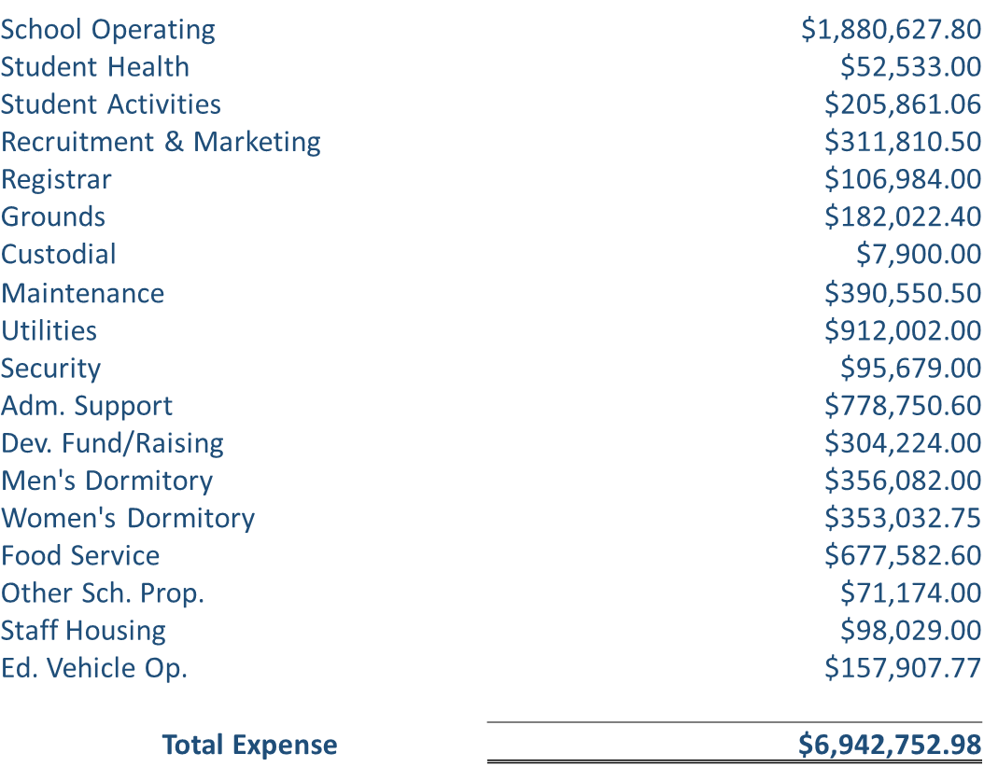
Expenses Summary

Slide 26
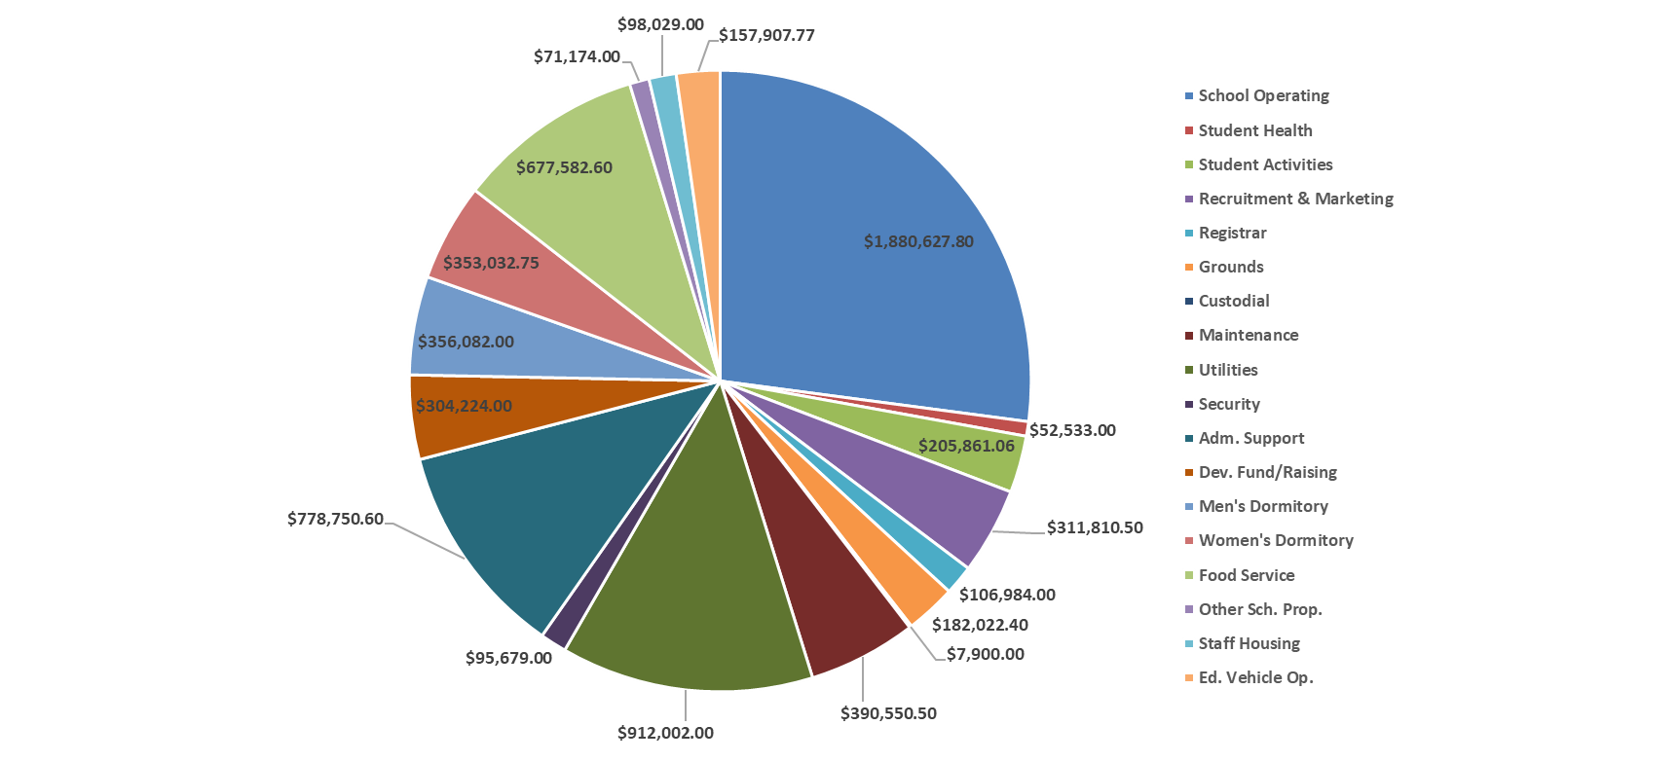
Expense Distribution

Slide 27
C.D.O.
Any SDA institution can't be successful with out a C.D.O.
All school should have a C.D.O.
The C.D.O. should be the above any administrator of your school
What is a C.D.O.?
Chief Development Officer? NO

Slide 28
C.D.O.
Chief
Divine
Officer
“I can do ALL things thru Jesus Christ who strengthens me”

