Slide 1

Enrollment Report
2018-19 School Year

Slide 2
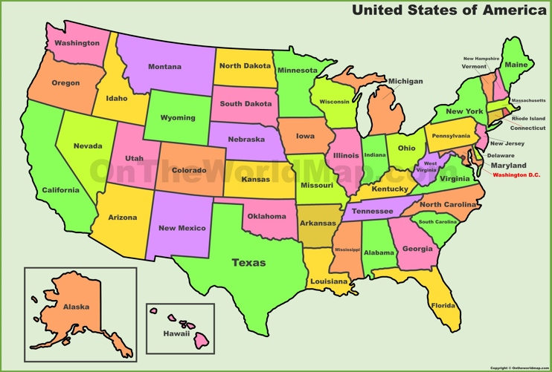
8 Southern Union States

Slide 3
Total Schools in NAD
2017 - 2018
965 Schools

Slide 4
Total Schools in Southern Union
2017 - 2018
197 Schools

Slide 5
NAD & Southern Union Schools
Southern Union
N.A.D.

Slide 6
NAD / Enrollment 84,907

Slide 7
Southern Union / Enrollment 18,586

Slide 8
Total Teachers in NAD

Slide 9
Total Teachers in SU

Slide 10
NAD – Schools by Size
1 Teacher | 187
2 Teachers | 152
3 Teachers | 92
4 Or More Teachers | 345

Slide 11
Southern Union - Schools by Size
1 Teacher | 27
2 Teachers | 39
3 Teachers | 17
4 Or More Teachers | 74

Slide 12
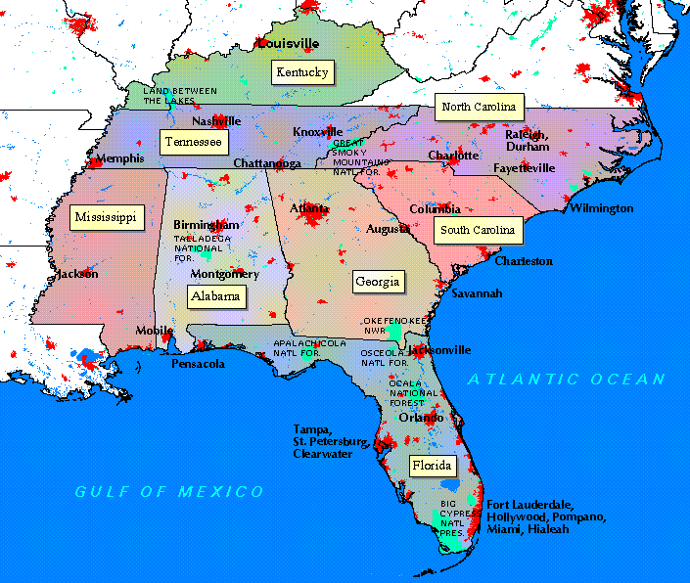
Boarding Schools in Southern Union - 5
Mt.Pisgah Acad
Georgia Cumberland
Academy
Forest Lake Academy
Bass Memorial
Academy
Highland Academy

Slide 13
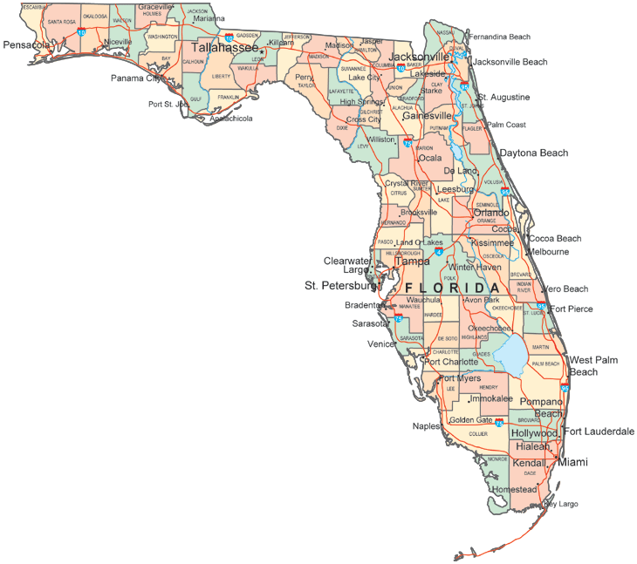
Florida
2018-19
School Year
29 Schools

Slide 14
29 Schools and 262 Teachers
1-3 Teachers
DAS
GCSDA
ICA
JES
LSA
MSAS
OACS - O
TACA
WHAA
ZLS
10
4-7 Teachers
BWAS
EPAA
GCS
JAA
NACS
NPRACA
OACS - K
PCAS
WCCA
WPBJA
10
8+ Teachers
FCAS
FLA
FLEC
GMAA
OJA
SAS
NTCA
WAKJA
WMA
9

Slide 15
PREK-12 Enrollment Trends

Slide 16
2018-19 PreK-12 Enrollment by Grade

Slide 17
Grades K-12 Enrollment with Scholarships

