Slide 1
Paying Substitute Teachers

Slide 2
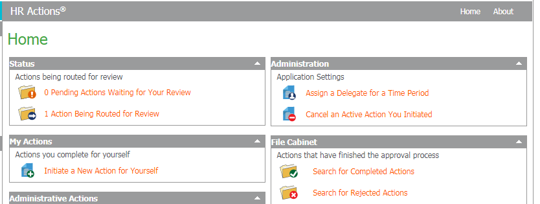
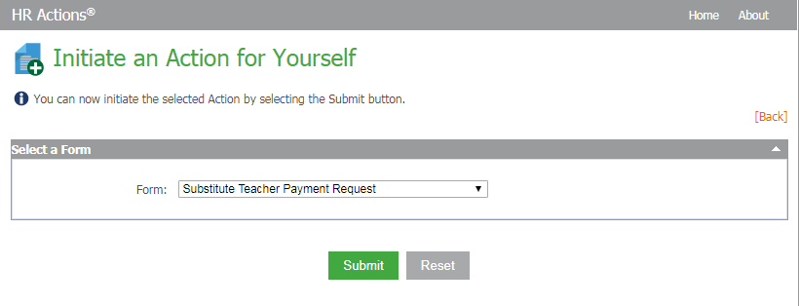

Slide 3
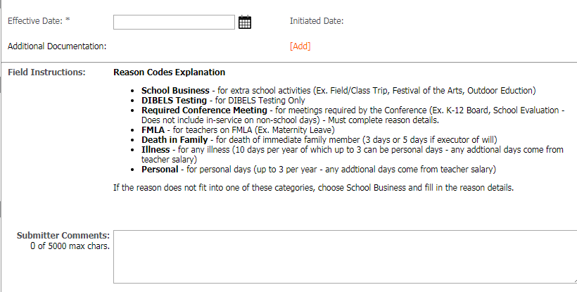

Slide 4
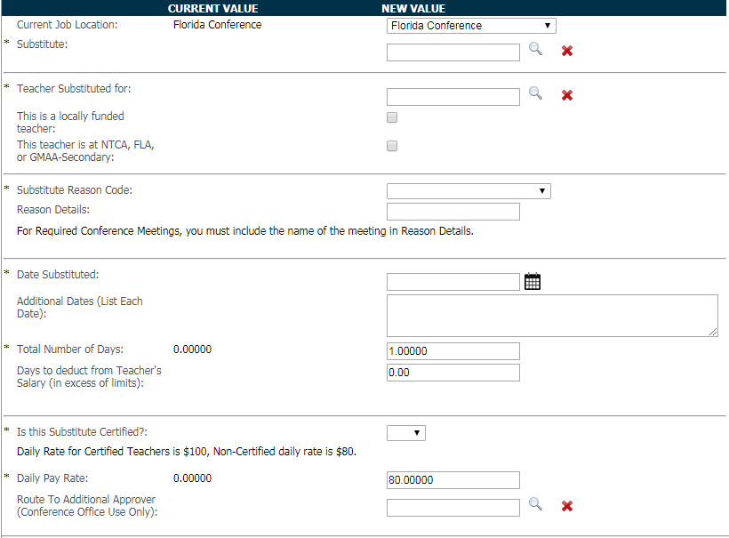
Make sure not to switch these!

Slide 5
Important Notes
Only for people who are substituting for a teacher. No other employees!
Substitute must have been hired, with a signed offer letter, as a Substitute Teacher

Slide 6
Questions?

