Slide 1
Student Scholarships & Best Practice
Presented by:
Linette Colon
Business Manager

Slide 2
What is Step Up for Students (SUFS)
In 2001, Florida Legislatures created the Tax Credit Scholarship Program. Program was set up to give corporations a dollar-for-dollar state tax credit for the money they contributed and to give students a scholarship to a qualifying private school or transportation to an out-of-district public school.
Today the program manages multiple scholarship programs serving over 100,000 students at 100%.
Florida Tax Credit is the largest scholarship program in the nation.

Slide 3
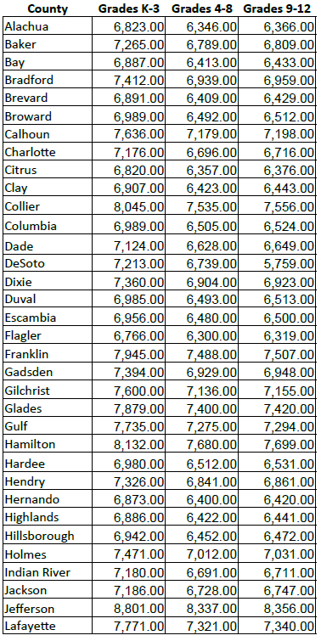
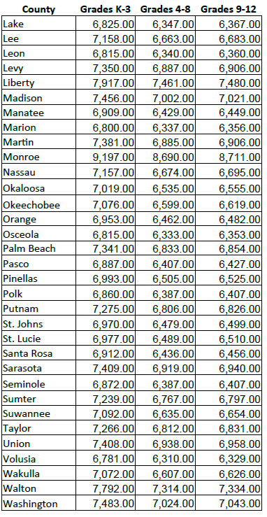
Funding – SUFS & FES

Slide 4
Step Up For Students
Students from our SDA community are receiving a Christian education
Tuition, registration, Administrative fee and other charges my be covered by the scholarship
Students are eligible for free or reduce lunch
Families may purchase uniforms if sold by the school
Students are able to participate in fine arts
Guaranteed income for participating school
Notes:
The average school in the 2014-2015 school year has 45 scholarship students

Slide 5
Family Empowerment vs SUFS
Awarded to students entering kindergarten, sibling of a kindergartener, or coming from the public school
“Once in always in”
Higher income base
Covers special programs, tutoring, therapy, summer school, other materials or activities related to the child’s education
Lunch & Before/After care are not covered
Notes:
The average school in the 2014-2015 school year has 45 scholarship students

Slide 6
Scholarship Challenges
Determine the allocation of funds
Scholarship exceeds tuition rates
Reconcile each scholarship student account
Refund the portion of scholarship not used

Slide 7
SUFS & FES Allocation
Reference Allocation Schedule

Slide 8
Best Practice
Best practices are a set of guidelines, ethics or ideas that represent the most efficient course of action in an organization
Familiarize with the Financial Statements
Balance Sheet, Income Statement, and Cash Flow Statement
Cash is key to effectively managing an organization
perform a daily & monthly reconciliation
use online banking
book adjustments
conduct deposits and transfers daily
Notes:
-Balance Sheet – this shows the company’s total assets, liabilities and capital at a particular point in time
Profit & Loss or Income Statement – shows the revenues generated and expenses incurred during a particular period
Cash Flow Statement – shows details of the flow of cash (inward and outward) as a result of the company’s operating, investment and financing activities.
-Make sure that the balance you have in your books matches your bank account.

Slide 9
Best Practice
Accounts Receivable
monitor accounts receivable
learn the account receivable aging report
identify areas for improvement
adhere to a collections policy

Slide 10
Best Practice
Fixed Assets
establish a capitalization threshold for items over a set amount
record them individually, not as a group
maintain a detailed description of assets
Review asset listing to ensure they exist and are in use
consider leasing versus buying

Slide 11
Best Practice
Accounts Payable
pay vendors in a timely manner
define thresholds to control purchasing
negotiate better pricing from vendors
ensure all invoices are properly approved prior to payment
Use of credit cards versus reimbursable expenses

Slide 12
Best Practice
Month-End Process
reconcile accounts weekly or daily to reduce workload at month or year end
use a month-end/year-end close checklist to eliminate errors
run journal entries reports and attach supporting documents
review financial statements for variances and journal entries needed

Slide 13
Best Practice
Business Plan/Budget
Preparing a budget/plan will help you project and estimate future expenses and the amount of income or revenue needed to sustain your operations
Process in Batches
process checks in batches on a certain time rather than processing every check request as they comes in

Slide 14
Best Practice
Review Your Processes
assess if processes are still ideal for how the department operates
Plan Your Hiring
plan the hiring of personnel
know the duties and responsibilities of your team
employee must have clear documented details of their responsibilities, accountabilities, hours of work, reporting relationship, compensation and benefits

Slide 15
Best Practice
Running a business should be challenging but fun. Challenging because its success all depends on you…on how much effort and dedication you are willing to give. If you set up proper systems and follow accounting best-practices, then your job could be a lot easier and FUN!

