Slide 1
School Treasurers’ Seminar 2020
Florida conference office of education

Slide 2
Prek-12 enrollment trends

Slide 3
Enrollment by grade

Slide 4
K-12 scholarships enrollment

Slide 5
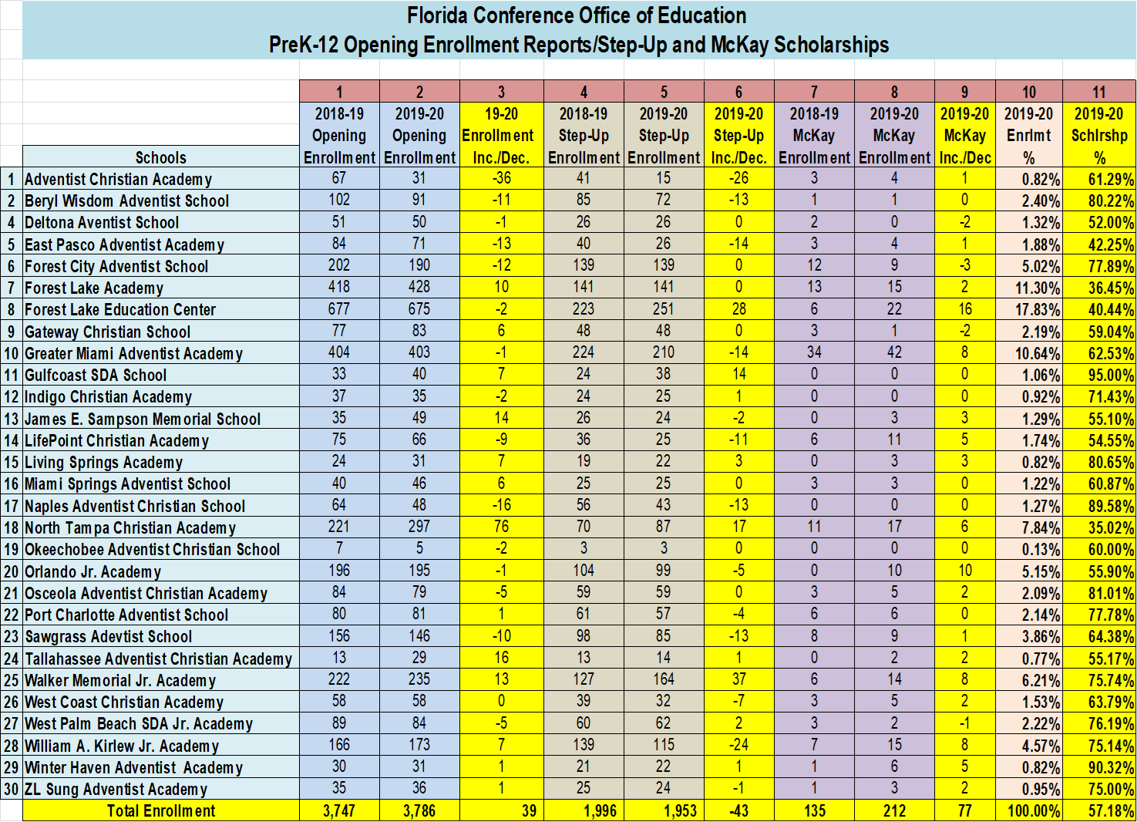

Slide 6
Luke 16:10-14
When the Pharisees, a money-obsessed bunch, heard him say these things, they rolled their eyes, dismissing him as hopelessly out of touch.
Jesus was not out of touch. He spoke the truth and struck a sensitive nerve with the Pharisees

Slide 10
Fraud is:
Is a persistent risk that doesn’t discriminate by size or type of organization. Fraud is an equal-opportunity problem.

Slide 11
The fraud triangle
Pressure
Opportunity
-Financial
-Personal
-Work
-Trust
-Internal Controls
Rationalization
-Justification
-Lack of Ethics

Slide 12
Pressure
The first component, pressure or incentive, is something that motivates someone to commit fraud.
Examples of pressures would include:
Financial stress-medical bills, “keeping up appearances”
Addictions-gambling, drugs, alcohol
Work-stress, workload, low wages,
no raises, resentment

Slide 13
rationalization
The second component of the Fraud Triangle is rationalization. This occurs when behaviors are logically justified.
Examples of this include:
I get no respect, I’ll get even
John makes more money than I do,
and I have more experience
I’ve done so much for them, they owe me
I’m only borrowing the money, I’ll
give it back next month

Slide 14
Opportunity
The final and most important component of the Fraud Triangle is opportunity. Opportunity not only permits fraud to occur, but actually promotes it.
Opportunity often exist because of:
A lack of internal control, or
A weakness in internal controls

Slide 15
Fraud summary
“Opportunity” is the only component of the Fraud Triangle within our control
A strong system of internal control plays an
important role by:
Protecting
entities against fraud
Guarding
employees from fraud
Keeping you out of the headlines

Slide 16
Fraud prevention
Management is responsible for designing
and implementing systems and controls to
prevent, deter and detect fraud
Antifraud systems and controls:
Create an ethical
culture
Implement antifraud
controls
Develop
effective
oversight

Slide 17
Next steps are:
A Risk Management Checklist to identify:
Generic risk factors
Individual risk factors
Overall risk factors
Internal control

Slide 18
Total teacher cost to the conference in 2020-21 school year
Number of Teachers
192.8 Budgeted for 2020-21 School Year
Teacher Salary and Allowances
$15,010,253
Teacher Cost of Housing (Cost of Living)
$971,316
Related Expenses (WC, Special Travel..Etc)
$326,251
Total Teacher Cost - $16,307,821

Slide 19
Miscellaneous items:
Substitute Reporting to Office of Education
Monthly Financial Reports to Office of Education (Balance Sheet/P&L)
Schools Treasurer Compensation for 2021-22 (Criteria)
Employment Cost Calculator (See Spreadsheet)

